Slide 1

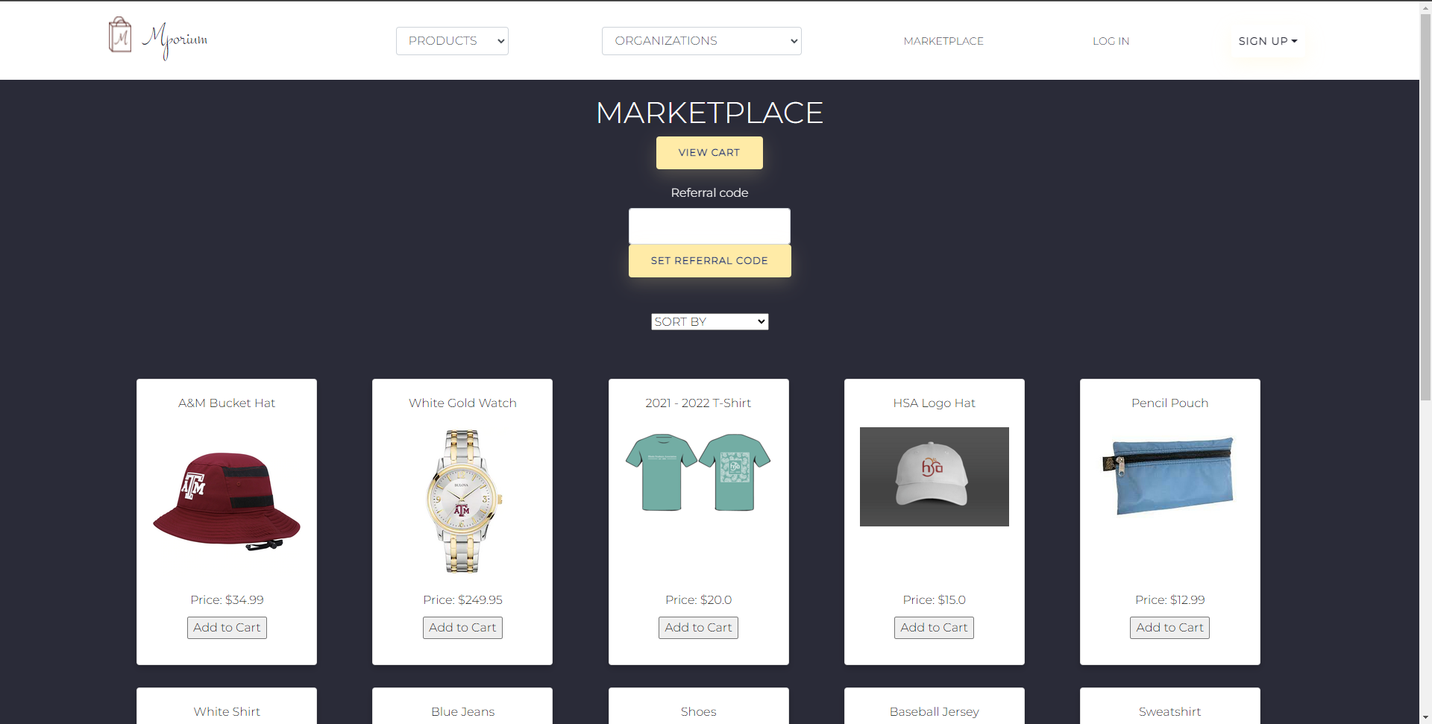
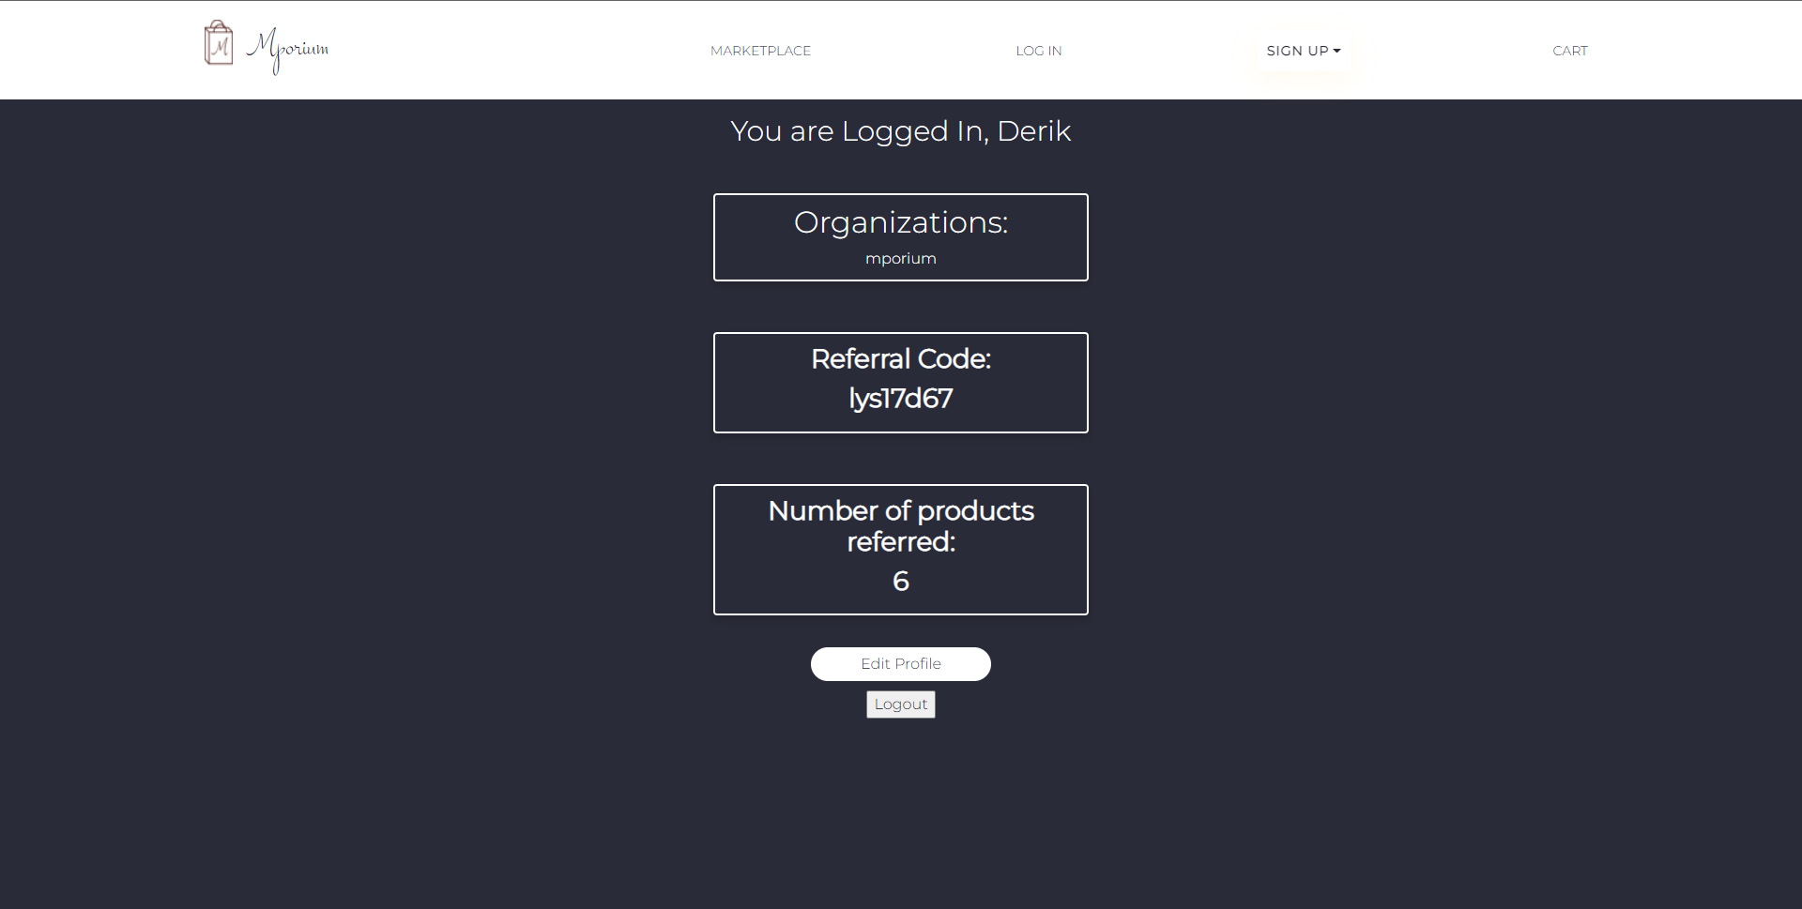
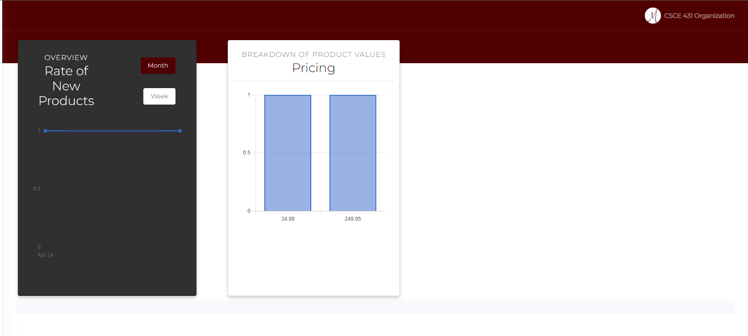
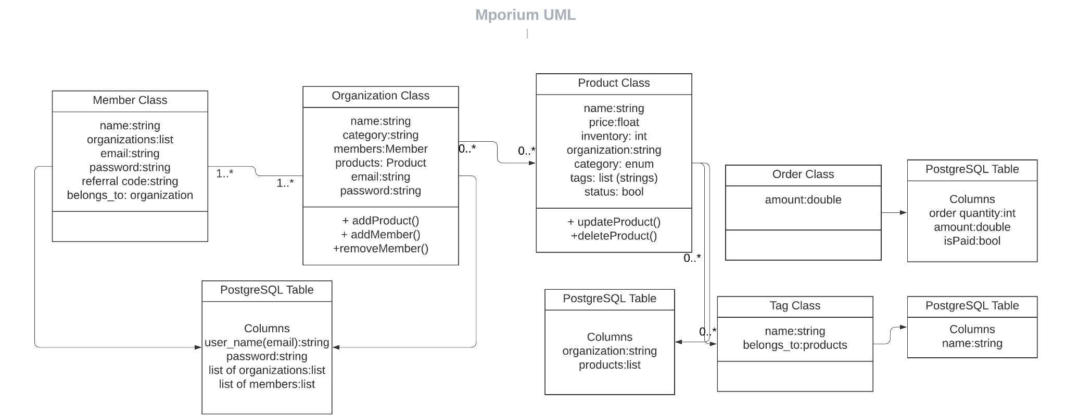
Development and Introduction to Mporium, A Student Organization Marketplace Hallie Scasta, Derik Wang, Keegan Choudhury, Anu Khatri
Motivation
Key Features
Mporium was created to address deficiencies in the current TAMU marketplace, including:
Lack of organization
Limited tools for orgs
No sorting & no sub-categories of filters for product search
No member dashboard
Intuitive design – easy for users to navigate the site
Secure Login – utilizes Google Auth to provide secure login for members and organizations
Easy Searching – filters & sorting provide organization when searching for products
Admin Tools – Member sales tracking & product analytics provided in organization dashboard
Design
Layout
Created For
Application is built around a few primary views:
Landing Page
Marketplace
Log-In / Sign-Up
Member Dashboard
Admin Dashboard
Organization Admins
Dashboard allows for easy monitoring of activity
Organization Members
Track sales by referral code
Customers
Ease of checkout with PayPal API
Use Cases
Marketplace
Member Dashboard
Organization Dashboard
Development
The application incorporated Amazon S3 Storage, Google Authentication, and PayPal to offer a smooth user experience
BDD and TDD tests were continuously created and ran to ensure the application was working as expected
The application was deployed to Heroku and achieved a 95% code coverage through testing.

